Slide 1
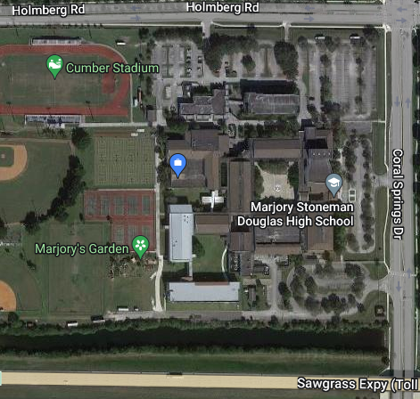
Judge Parking Zone
DO NOT PARK HERE
Bikes
Bus Loop

